Slide 1
Evaluating Differences in C-Section rates among Swiss Hospitals
CAS ADS Module 2 Group Project
Gaëlle Marti, Simon Rime, Lenja Flütsch
09.10.2023

Slide 2
Outline
Relevance of the Topic
Research Question
Data Acquisition & Cleaning
Descriptive Statistics
Part 1: Analysis & Conclusion
Part 2: Analysis & Conclusion
Evaluation / Discussion

Slide 3
Relevance
«When medically necessary, a caesarean section can effectively prevent maternal and newborn mortality. Two new studies show that when caesarean section rates rise towards 10% across a population, the number of maternal and newborn deaths decreases. When the rate goes above 10%, there is no evidence that mortality rates improve.»
Source : Betran AP, Torloni MR, Zhang JJ, Gülmezoglu AM; WHO Working Group on Caesarean Section. WHO Statement on Caesarean Section Rates. BJOG. 2016 Apr;123(5):667-70. doi: 10.1111/1471-0528.13526. Epub 2015 Jul 22. PMID: 26681211; PMCID: PMC5034743.

Slide 4

Relevance
No evidence that mortality improves
Surgical procedure associated with risks and complications
Inefficient use of limited healthcare resources
«Monitoring within country variation is also crucial and policy-makers should consider the use of monitoring (…) to evaluate trends on CS rates and maternal and infant outcomes in a more action-oriented and meaningful manner.»
Source:Betran AP, Ye J, Moller AB, Souza JP, Zhang J. Trends and projections of caesarean section rates: global and regional estimates. BMJ Glob Health. 2021 Jun;6(6):e005671. doi: 10.1136/bmjgh-2021-005671. PMID: 34130991; PMCID: PMC8208001.

Slide 5

Outline
Relevance of the Topic
Research Question
Data Acquisition & Cleaning
Descriptive Statistics
Part 1: Analysis & Conclusion
Part 2: Analysis & Conclusion
Evaluation / Discussion

Slide 6
Research Question
Part 1:
Part 2:
Is there a statistically significant difference in inpatient cesarean section rates between the Latin-speaking cantons (GE, VD, NE, JU, FR, VS, TI) and the German-speaking cantons in Switzerland?
What is the relationship between hospital attributes, including infrastructure and personnel, and the rate of C-section procedures?

Slide 7
Outline
Relevance of the Topic
Research Question
Data Acquisition & Cleaning
Descriptive Statistics
Part 1: Analysis & Conclusion
Part 2: Analysis & Conclusion
Evaluation / Discussion

Slide 8
Data Acquisition
Table 1: Acquired Data
Required Data | Variables of the imported Datasets | Source | Year
C-Section Data | Hospital name | Key figures of Swiss hospitals, Federal Office of Public Health | 2015 - 2021
 | Hospital location (Canton)
 | Number of C-Sections per Hospital
Kidney Transplantation | Hospital name | Key figures of Swiss hospitals, Federal Office of Public Health | 2015 - 2021
 | Hospital location (Canton)
 | Number of Kidney Transplantations per Hospital
Inpatient Birth | Hospital name | Key figures of Swiss hospitals, Federal Office of Public Health | 2015 - 2021
 | Hospital location (Canton)
 | Number of inpatient deliveries per Hospital
Hospital Infrastructure and Staff | Hospital name | Key figures of Swiss hospitals, Federal Office of Public Health | 2015 - 2021
 | Hospital location (Canton)
 | Number of Doctors
 | Number of Doctors in training
 | Number of Nurses
 | Number of other medical staff (operation technicians, physiotherapists etc.)
 | Number of Total Staff
 | Number of Operation Rooms
 | Number of Delivery Rooms
 | Private Division (y/n)
 | Number of Beds

Slide 9
Data Acquisition
All Hospitals with > 0 cases are listed
Creation of a new variable for whether Hospitals are in latin-speaking cantons:
«R0» for latin speaking cantons 'GE','VD','NE','JU','FR','VS','TI’
«AL» for all other cantons
Creation of a new variable for University Hospitals
1 for University Hospitals
Inselspital Bern, Universitätsspital Zürich, Universitätsspital Basel, CHUV Lausanne, HUG Geneva
0 for Non-university Hospitals
Creation of a new variable for Percentage C-Sections
Number of C-Sections / Deliveries

Slide 10
Data Cleaning
Removing „Maison de Naissance“ and „Geburtshaus“ from the list of hospitals as these establishments do not carry out C-Sections
96 Establishements with the string ‚Naissance‘ or ‚Geburtshaus‘ were removed from the dataframe
Removing other institutions that do not carry out C-Sections
12 Institutions were removed that do not carry out C-Sections
Removing lines in the dataframe that do not contain the number of beds
98 Lines were removed that did not contain any information on the number of beds or doctors in the hospital

Slide 11
Outline
Relevance of the Topic
Research Question
Data Acquisition & Cleaning
Descriptive Statistics
Part 1: Analysis & Conclusion
Part 2: Analysis & Conclusion
Evaluation / Discussion

Slide 12
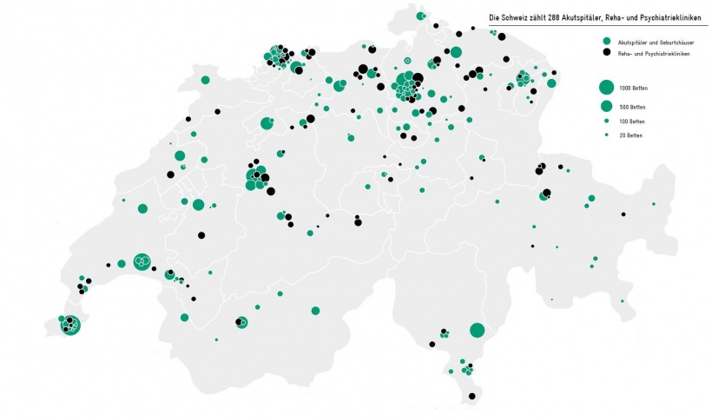
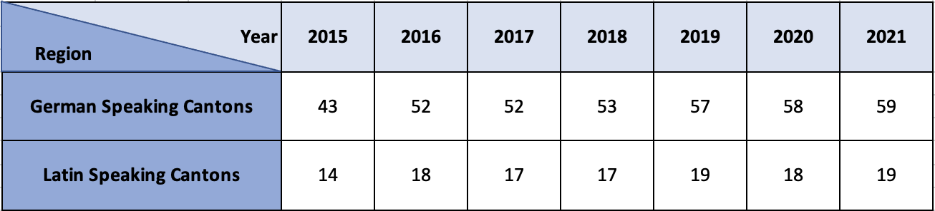
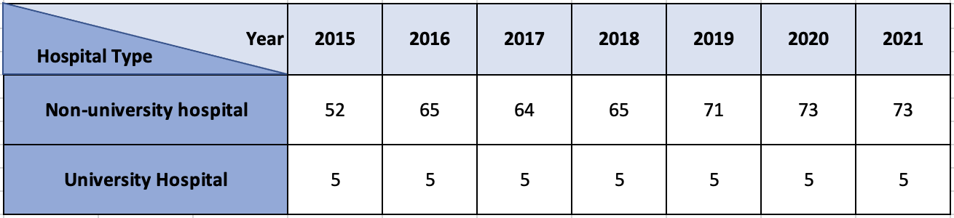
Descriptive Statistics
Table 2: Number of Hospitals grouped by region and year
Table 3: Number of Hospitals grouped by hospital type and year
Sample Illustration of Swiss Hospitals by Avenir Suisse based on BAG Data from 2017

Slide 13
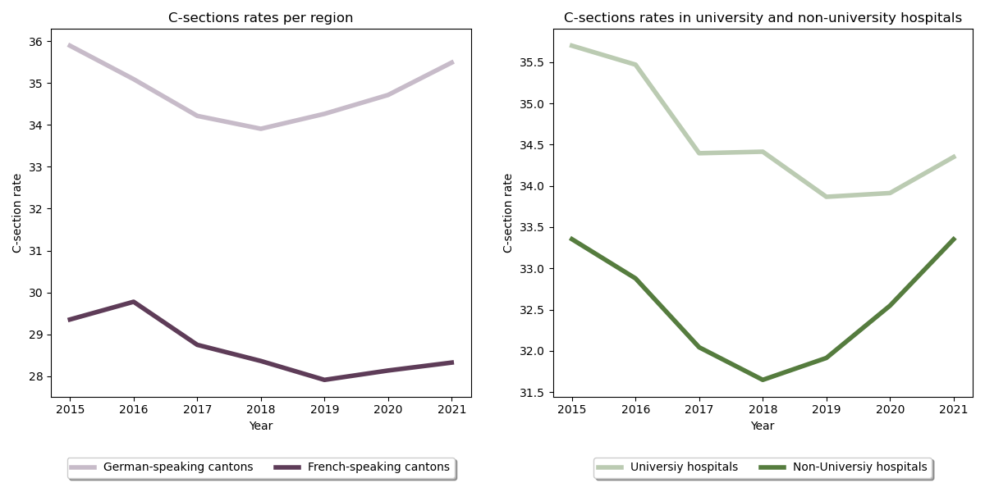
Descriptive Statistics

Slide 14
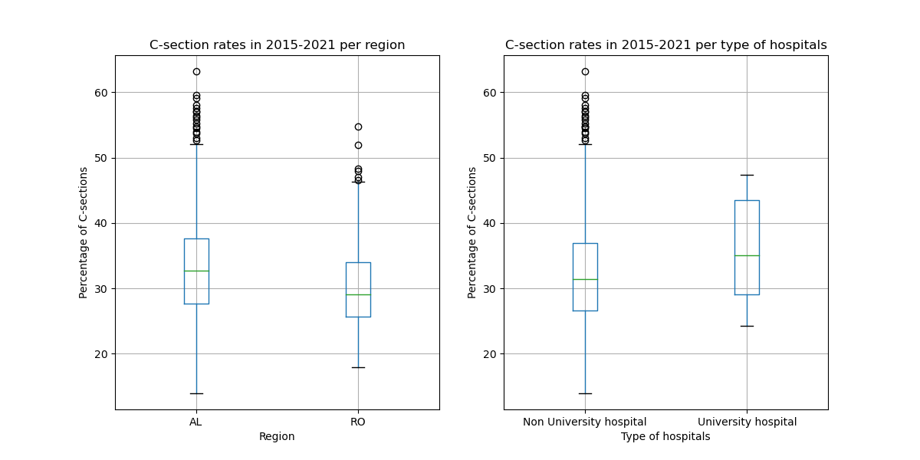
Descriptive Statistics

Slide 15
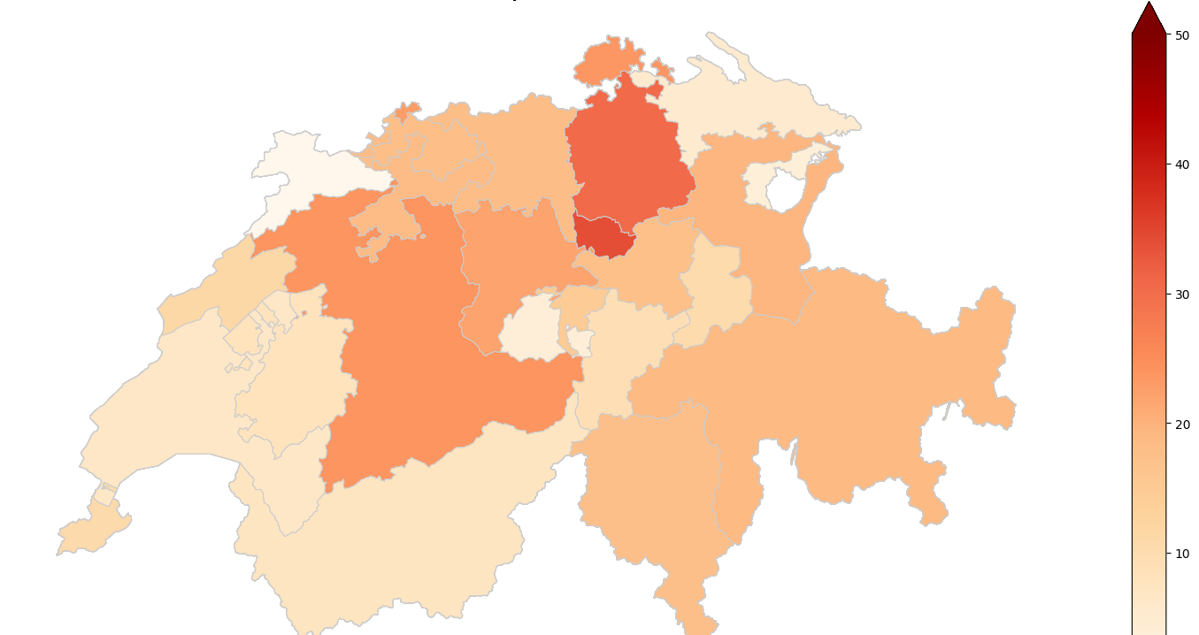
Descriptive Statistics
Map 1: Inpatient C-Section rates per canton in 2021
Canton | C-Section Rate
Zug | 41.5
Zürich | 39.1
Bern | 36.2
Schaffhausen | 36.0
Basel-Stadt | 35.7
Lucerne | 35.2
Valais | 34.4
Sankt Gallen | 34.0
Graubünden | 33.6
Solothurn | 33.5
Aargau | 33.3
Basel-Landschaft | 33.2
Schwyz | 32.9
Nidwalden | 31.3
Ticino | 31.2
Neuchâtel | 29.6
Genève | 29.3
Glaurs | 29.0
Uri | 28.4
Fribourg | 27.8
Vaud | 27.1
Thurgau | 26.3
Obwalden | 25.6
Appenzell Ausserrhoden | 25.5
Jura | 23.6

Slide 16
Outline
Relevance of the Topic
Research Question
Data Acquisition & Cleaning
Descriptive Statistics
Part 1: Analysis & Conclusion
Part 2: Analysis & Conclusion
Evaluation / Discussion

Slide 17
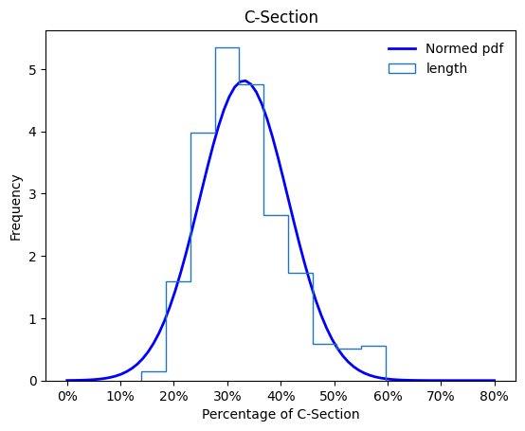
Part 1: Analysis - Distribution
Question: Is there a statistically significant difference in inpatient cesarean section rates between the Latin-speaking cantons (GE, VD, NE, JU, FR, VS, TI) and the German-speaking cantons in Switzerland?
Skew: 0.87 → Our distribution is skewed toward the left
Kurtosis: 0.80 → Our distribution is more heavy-tailed compared to the normal distribution
Notes:
If Skew >0 = skewed towards the left

Slide 18
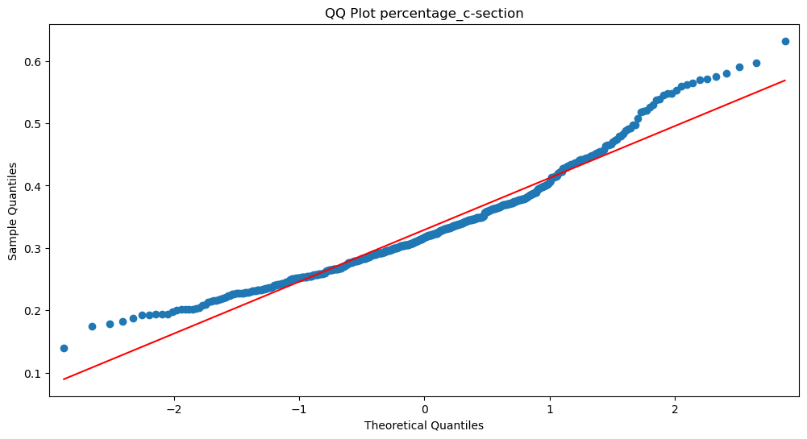
Part 1: Analysis – Normality
Question: Is there a statistically significant difference in inpatient cesarean section rates between the Latin-speaking cantons (GE, VD, NE, JU, FR, VS, TI) and the German-speaking cantons in Switzerland?
D‘Agostino Pearson Test:
H₀ = Data follows a normal distribution
Alpha = 0.001
P = 2.93x10⁻¹³
H₀ can be rejected
Our data is not normally distributed

Slide 19
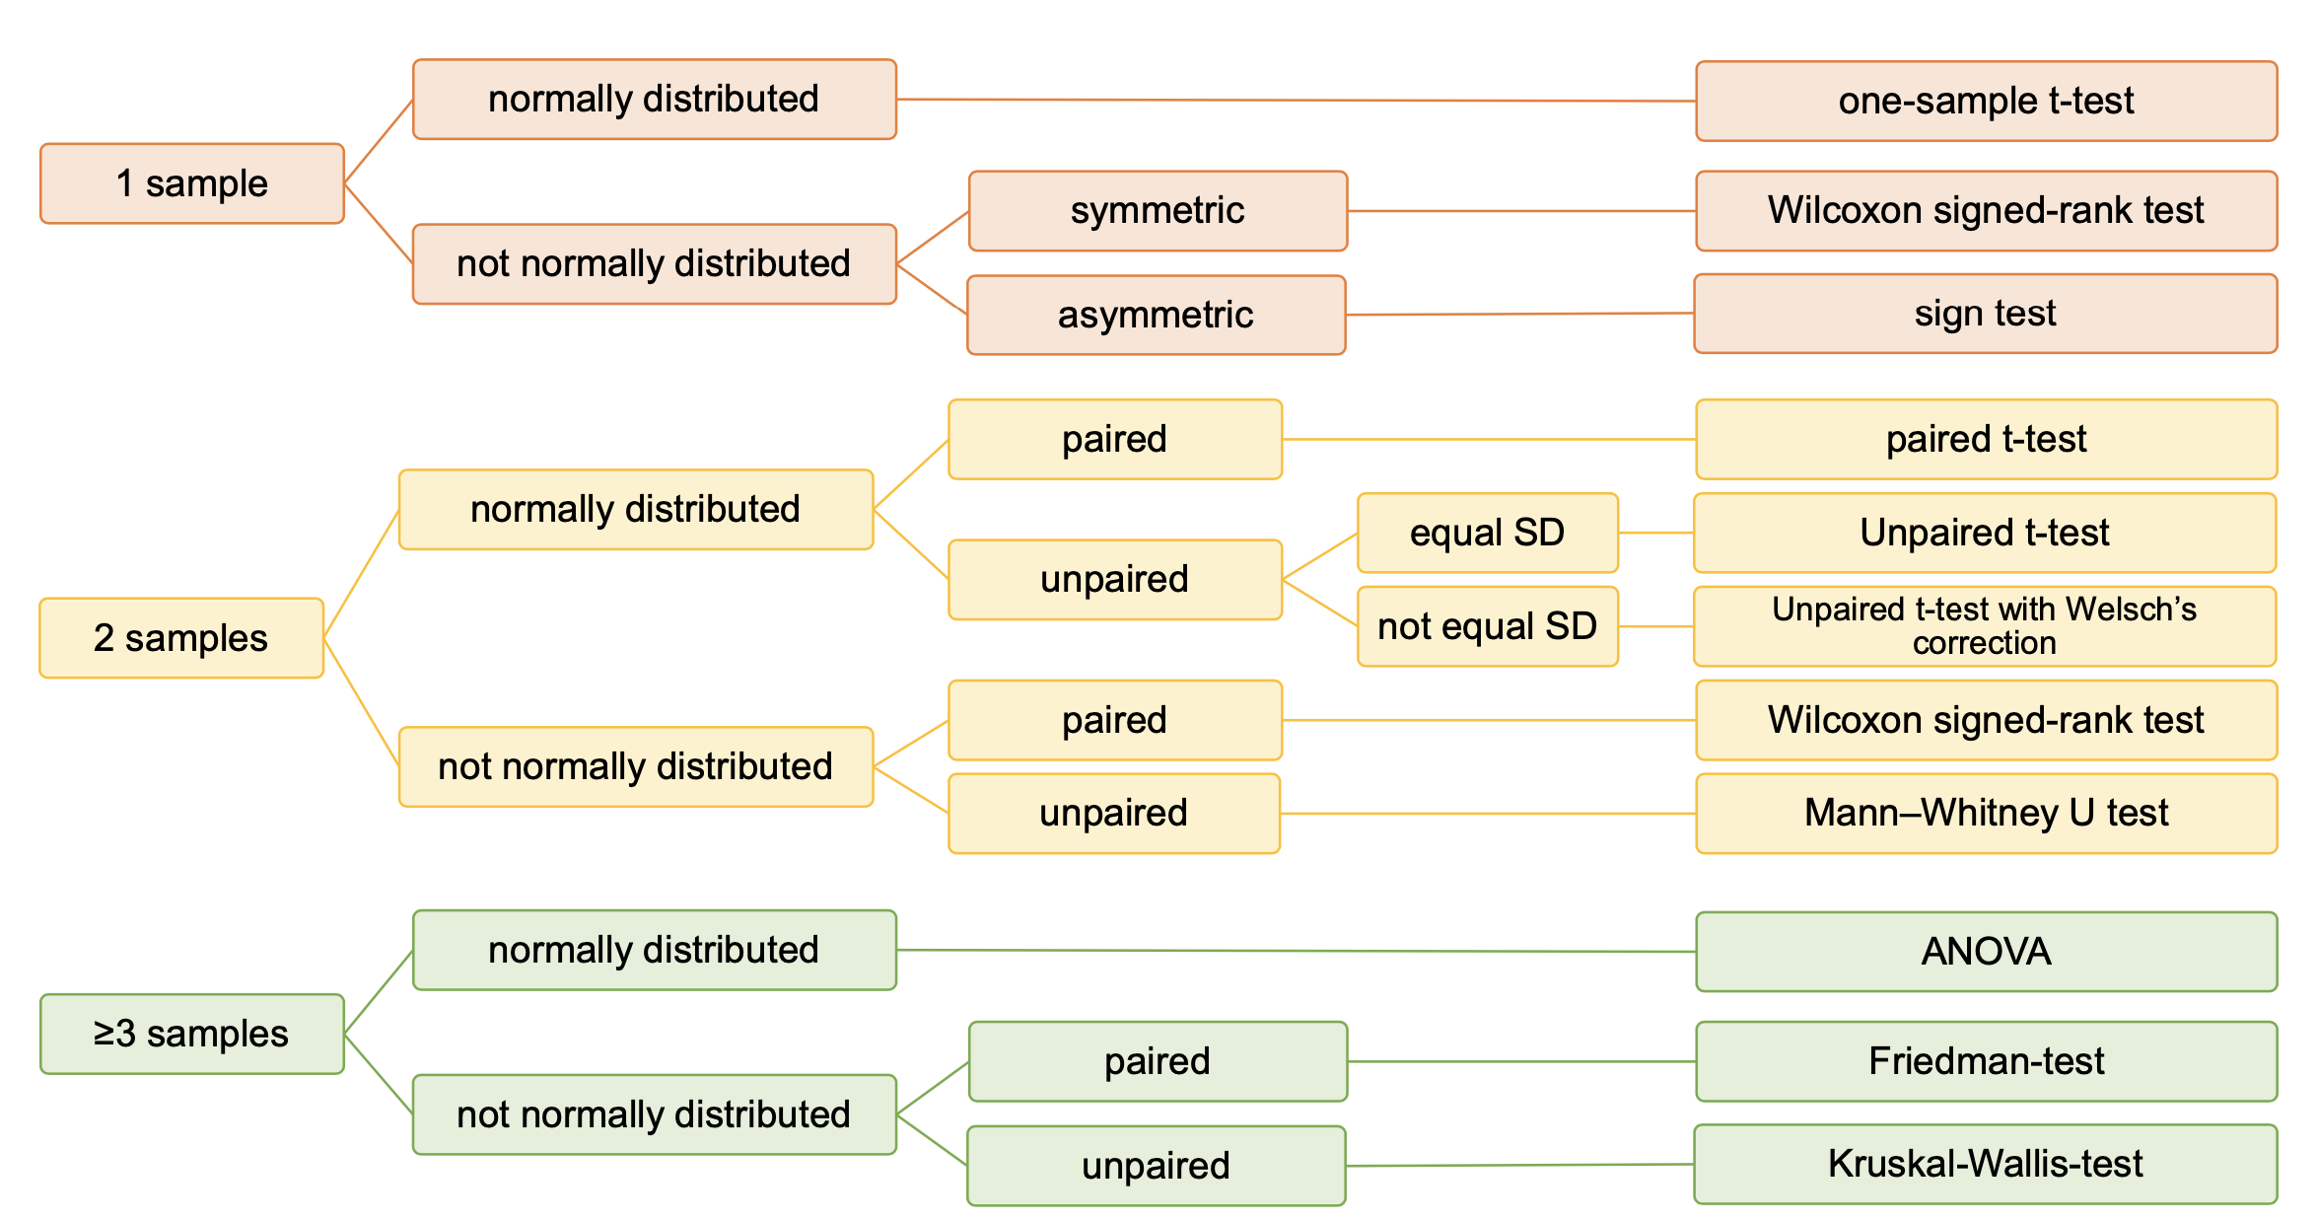
Part 1: Analysis – Hypothesis testing

Slide 20
Part 1: Analysis – Hypothesis testing
Question: Is there a statistically significant difference in inpatient cesarean section rates between the Latin-speaking cantons (GE, VD, NE, JU, FR, VS, TI) and the German-speaking cantons in Switzerland?
Mann-Whitney U Test
Chosen significance Level = 0.05
Comparing the German to the Latin speaking cantons
P-value = 0.00567
We reject the null hypothesis and conclude that there is a statistically significant difference between the two groups.
Comparing university hospitals to non-university hospitals
P-value = 0.01161
We reject the null hypothesis and conclude that there is a statistically significant difference between the two groups.

Slide 21
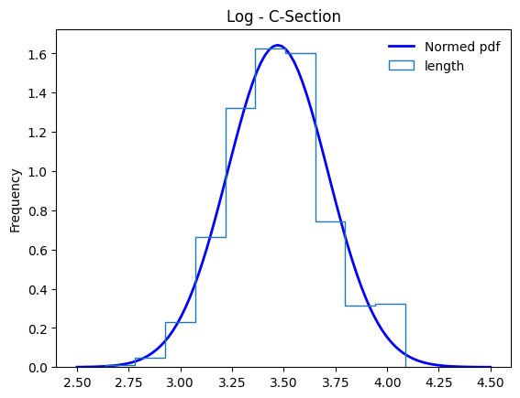
Part 1: Analysis – Normality
Question: Is there a statistically significant difference in inpatient cesarean section rates between the Latin-speaking cantons (GE, VD, NE, JU, FR, VS, TI) and the German-speaking cantons in Switzerland?
What if we take the log of the C-Section rate?
Skew: 0.16 → Our distribution is skewed toward the left
Kurtosis: 0.01 → Our distribution is slightly more heavy-tailed compared to the normal distribution

Slide 22
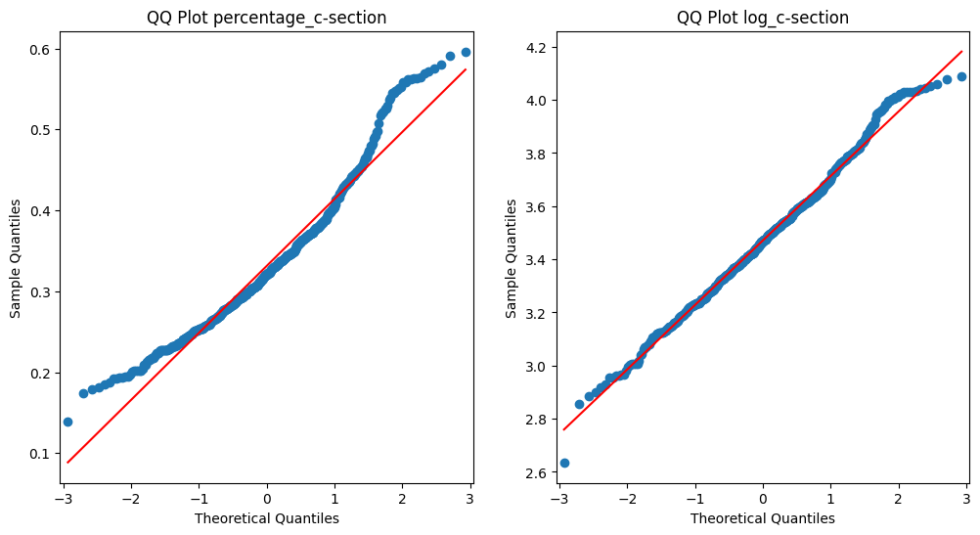
Part 1: Analysis – Normality
Question: Is there a statistically significant difference in inpatient cesarean section rates between the Latin-speaking cantons (GE, VD, NE, JU, FR, VS, TI) and the German-speaking cantons in Switzerland?
D‘Agostino Pearson Test:
H₀ = Data follows a normal distribution
Alpha = 0.001
P = 0.335
H₀ can not be rejected
Using the log we created a normally distributed dataset

Slide 23
Part 1: Analysis - Variance
Question: Is there a statistically significant difference in inpatient cesarean section rates between the Latin-speaking cantons (GE, VD, NE, JU, FR, VS, TI) and the German-speaking cantons in Switzerland?
Do we have equal or unequal standard deviations?
Cantons | German-speaking | Latin-speaking
Standard Deviation | 0.249 | 0.228
Levene‘s Test:
H₀ = All input samples are from populations with equal variances
P = 0.522
H₀ can not be rejected
We can assume equal variance for our dataset

Slide 24
Part 1: Analysis – Hypothesis testing

Slide 25
Part 1: Analysis – Hypothesis testing
Question: Is there a statistically significant difference in inpatient cesarean section rates between the Latin-speaking cantons (GE, VD, NE, JU, FR, VS, TI) and the German-speaking cantons in Switzerland?
Unpaired T-Test
Chosen significance Level = 0.05
Comparing the German to the Latin speaking cantons
P-value = 0.018
We reject the null hypothesis and conclude that there is a statistically significant difference between the two groups.
Comparing university hospitals to non-university hospitals
P-value = 0.014
We reject the null hypothesis and conclude that there is a statistically significant difference between the two groups.

Slide 26
Part 1: Conclusion
Research Question: Is there a statistically significant difference in inpatient cesarean section rates between the Latin-speaking cantons (GE, VD, NE, JU, FR, VS, TI) and the German-speaking cantons in Switzerland?
Answer: Yes!
Test | Mann-Whitney U | Unpaired T-Test
P-value | 0.0056 | 0.018

Slide 27

Part 1: Conclusion
Source: RTS, l'Observatoire de la santé (Obsan)

Slide 28
Outline
Relevance of the Topic
Research Question
Data Acquisition & Cleaning
Descriptive Statistics
Part 1: Analysis & Conclusion
Part 2: Analysis & Conclusion
Evaluation / Discussion

Slide 29
Part 2: Analysis – Data Preparation
Question: What is the relationship between hospital attributes, including infrastructure and personnel, and the rate of C-section procedures?
We have already checked previously that the log of the C-section rate follows a normal distribution
1 or 0 for hospitals that do or do not perform kidney transplants
In order to be able to better compare hospitals of very different size, we normalized our variables to the number of beds:
df['doc_bed'] = df['Doctor']/df['Beds']
df['nurse_bed'] = df['Nurse']/df['Beds']
df['staff_bed'] = df['Total_staff']/df['Beds']
df['operat_bed'] = df['Operation_rooms']/df['Beds']
df['deliv_bed'] = df['Delivery_rooms']/df['Beds']

Slide 30
Part 2: Analysis – Regression
Question: What is the relationship between hospital attributes, including infrastructure and personnel, and the rate of C-section procedures?
Results of the Ordinary Least Square Regression:
Variable | P-Value
Intercept | 0.008
Year [2015 - 2021] | 0.002
Region (German/Latin) | 0.000
University Hospital (y/n) | 0.007
Total Staff / Bed | 0.016
Operating Theaters / Bed | 0.000
Delivery Rooms /Bed | 0.000
Private Division (y/n) | 0.000
Performs Kidney Transplantation (y/n) | 0.021
Doctors / Bed | 0.111
Nurses / Bed | 0.382
R²
The proportion of variance in the dependent variable explained by the independent variable
higher R² = better fit
R² = 0.478

Slide 31
Part 2: Analysis – Regression
Question: What is the relationship between hospital attributes, including infrastructure and personnel, and the rate of C-section procedures?
Result OLS-Regression using only the significant variables
Variable | P-Value | Coefficient | 95% CI
Intercept | 0.011 | -21.8825 | [-38.761, -5.004)
Year [2015 - 2021] | 0.004 | 0.0124 | [0.004, 0.021]
Region (German/Latin) | 0.000 | -0.1346 | [-0.173, -0.096]
University Hospital (y/n) | 0.000 | 0.3141 | [0.233, 0.395]
Total Staff / Bed | 0.000 | -0.0513 | [-0.065, -0.037]
Operating Theaters / Bed | 0.000 | 3.0191 | [1.690, 4.348]
Delivery Rooms /Bed | 0.000 | -4.0009 | [-5.337, -2.665]
Private Division (y/n) | 0.000 | 0.4927 | [0.396, 0.589]
Kidney Transplantation (y/n) | 0.037 | 0.1360 | [0.008, 0.264)
R²
higher R² = better fit
R² = 0.471

Slide 32
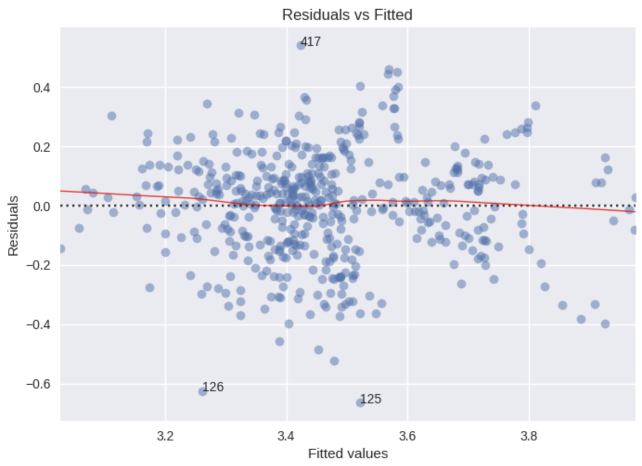


Part 2: Analysis – Regression Evaluation
Question: What is the relationship between hospital attributes, including infrastructure and personnel, and the rate of C-section procedures?
Residuals seem to be randomly distributed around 0
Residuals do not show a clear pattern
However we might have unequal variances (=heteroscedasticy) as the spread of our residuals narrows and widens as the fitted values change → We check this later

Slide 33
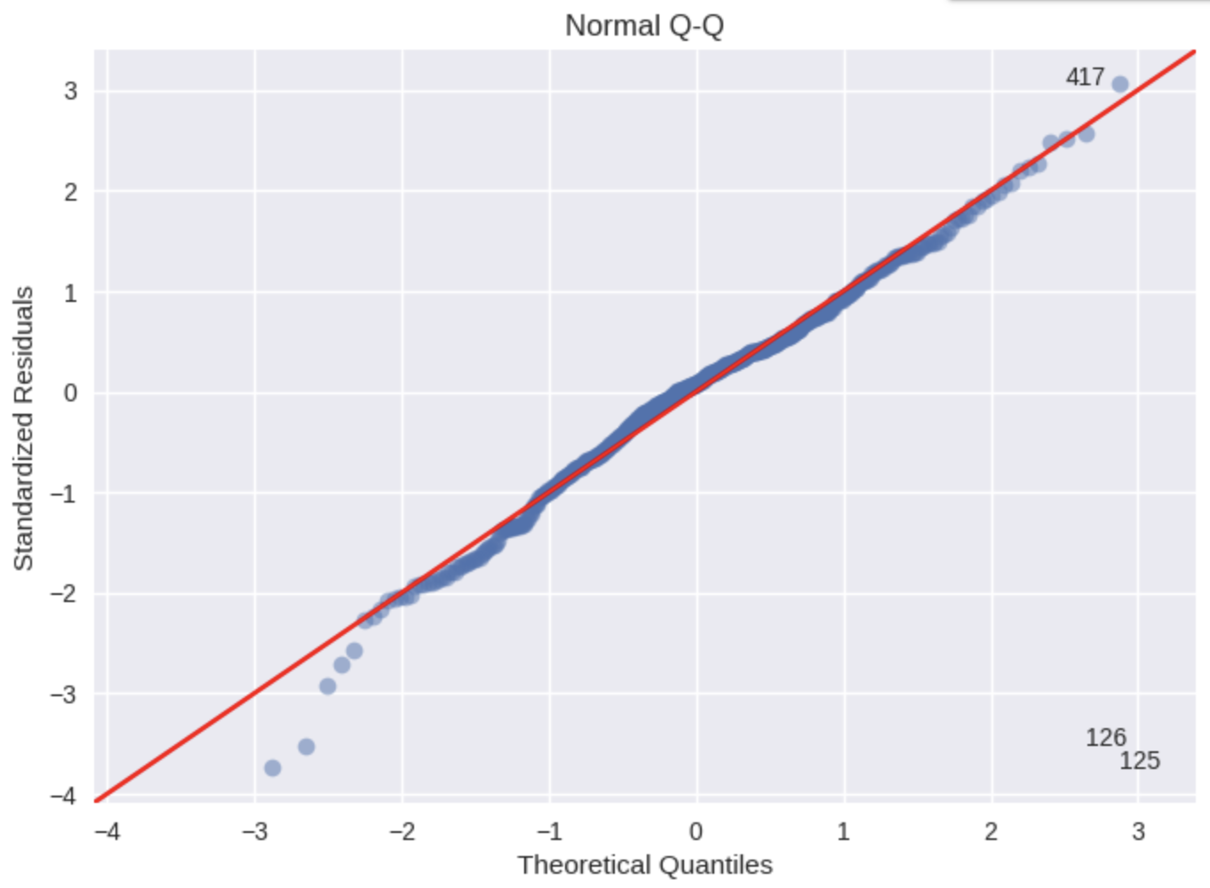
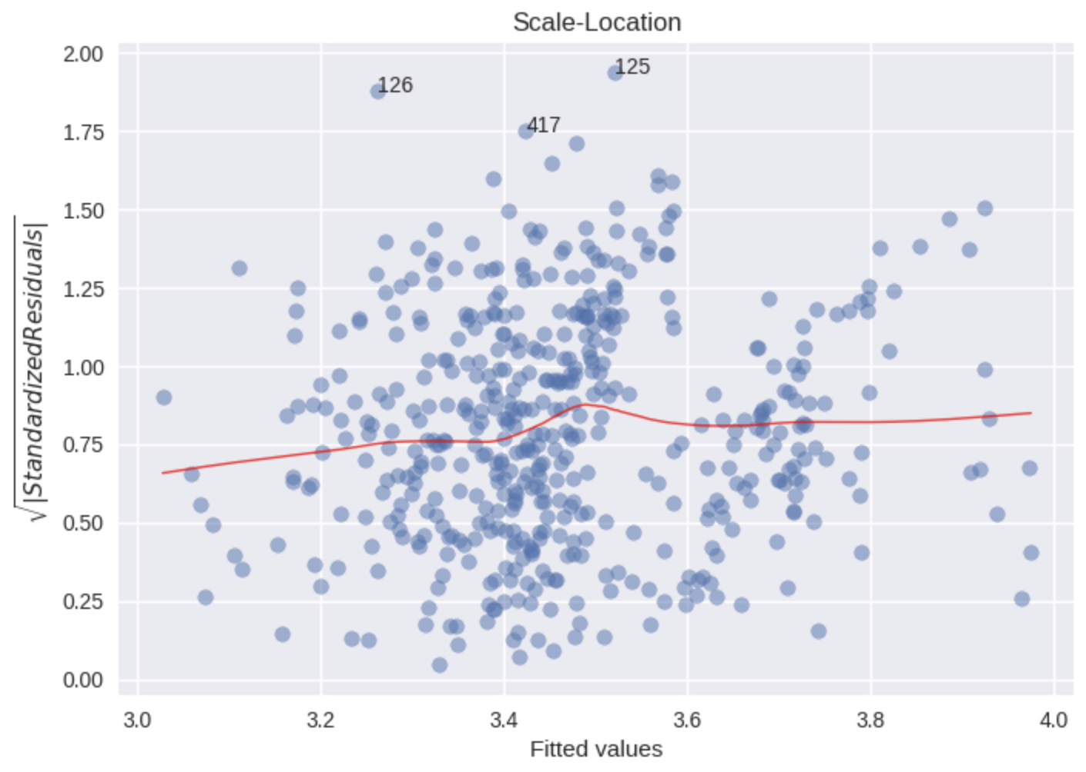
Part 2: Analysis – Regression Evaluation
Question: What is the relationship between hospital attributes, including infrastructure and personnel, and the rate of C-section procedures?
Assessing Normality
Assessing Homoscedasticity
Notes:
Assessing Normality
A good normal QQ plot has all of the residuals lying on or close to the red line.
Looking at the graph above, there are several points that fall far away from the red line.
This is indicative of the errors not being normally distributed, in fact our model suffers from “heavy tails”.
What does this say about the data? We are more likely to see extreme values than to be expected if the data was truly normally distributed.
Assessing Homoscedasticy
The more horizontal the red line is, the more likely the data is homoscedastic.
We clearly have homoscedasticity. This might be caused by not capturing the non-linearities in the model (see Residuals vs Fitted plot)

Slide 34
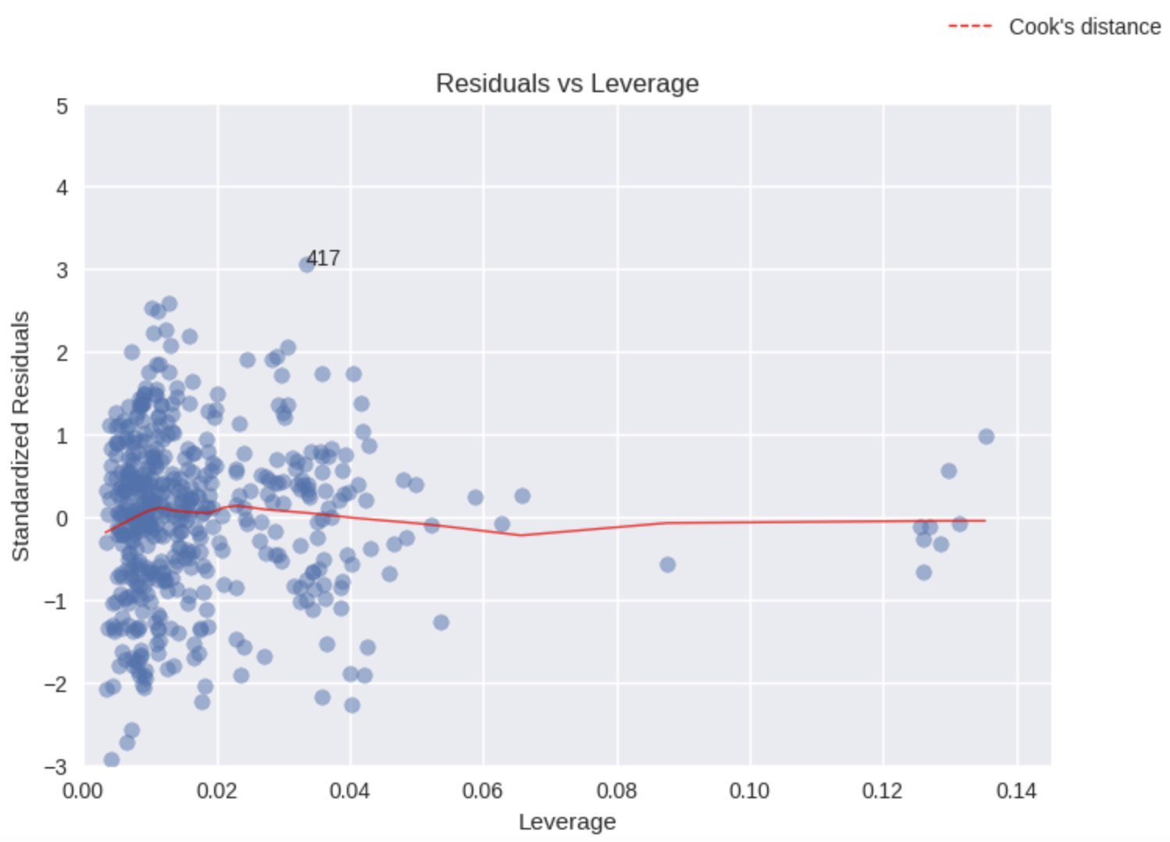
Part 2: Analysis – Regression Evaluation
Question: What is the relationship between hospital attributes, including infrastructure and personnel, and the rate of C-section procedures?
Looking for Influential Points
Influential Points:
are outliers (have large standardized residuals)
have high leverage (points that have the potential to strongly influence the regression coefficients)
Notes:
# Thanks to Cook’s Distance, we only need to find leverage points that have a distance greater than 0.5.
# In this plot, we do not have any leverage points that meet this criteria.

Slide 35
Part 2: Conclusion
Research Question: What is the relationship between hospital attributes, including infrastructure and personnel, and the rate of C-section procedures?
Variable | P-Value | Coefficient | 95% CI
Intercept | 0.011 | -21.8825 | [-38.761, -5.004)
Year [2015 - 2021] | 0.004 | 0.0124 | [0.004, 0.021]
Region (German/Latin) | 0.000 | -0.1346 | [-0.173, -0.096]
University Hospital (y/n) | 0.000 | 0.3141 | [0.233, 0.395]
Total Staff / Bed | 0.000 | -0.0513 | [-0.065, -0.037]
Operating Theaters / Bed | 0.000 | 3.0191 | [1.690, 4.348]
Delivery Rooms /Bed | 0.000 | -4.0009 | [-5.337, -2.665]
Private Division (y/n) | 0.000 | 0.4927 | [0.396, 0.589]
Kidney Transplantation (y/n) | 0.037 | 0.1360 | [0.008, 0.264)
Strongest Relationships:
Delivery Rooms/Bed (inverse relationship)
Operating Theaters/Bed

Slide 36
Outline
Relevance of the Topic
Research Question
Data Acquisition & Cleaning
Descriptive Statistics
Part 1: Analysis & Conclusion
Part 2: Analysis & Conclusion
Evaluation / Discussion

Slide 37
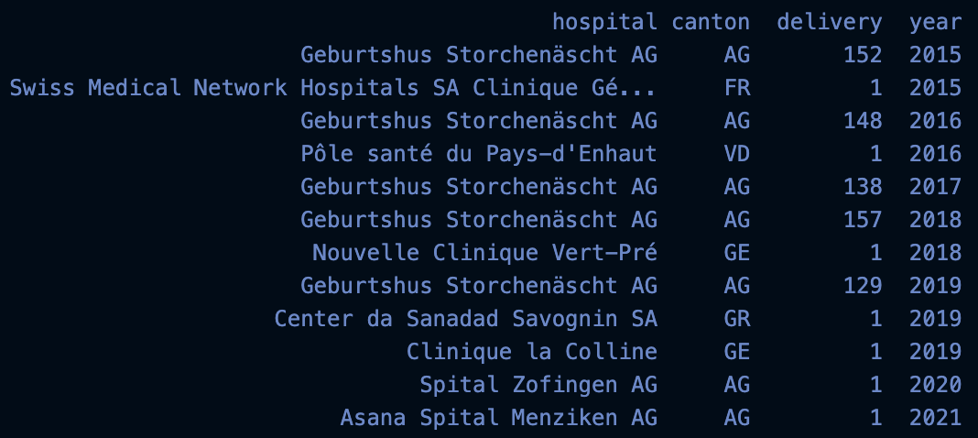
Discussion
Where we justified in eliminating Hospitals that hadn‘t performed any C-Sections in a specific year?

Slide 38
Discussion
Were we justified in removing the 98 lines without bed?
Alternative options: Replacing the missing values be the means of the last years?
Checking manually if the data is available elsewhere?

Slide 39
Thank you for your attention!

